Slide 1
Solid State Computing
Dr. Charles R. Severance
www.ca4e.com
online.dr-chuck.com

Slide 2
Outline
The transistor replacing tubes in digital applications
Faster than a relay or tube
Far less heat and electricity
More reliable and long lasting
No moving parts
Amplifiers, Tubes and Transistors – It's complicated
Transistor radios
Evolution of transistor technology and manufacturing
BJT -> PMOS -> NMOS -> CMOS
The "digital logic gate" abstraction
Transistor density and scale
VLSI – Chip Layout and manufacture
Notes:
BJT = Biploar Junction Transistor
PMOS = P-channel Metal-Oxide-Semiconductor
NMOS = N-channel Metal-Oxide-Semiconductor
CMOS = Complimentary Metal-Oxide-Semiconductor
VLSI = Very Lage Scale Integration

Slide 3
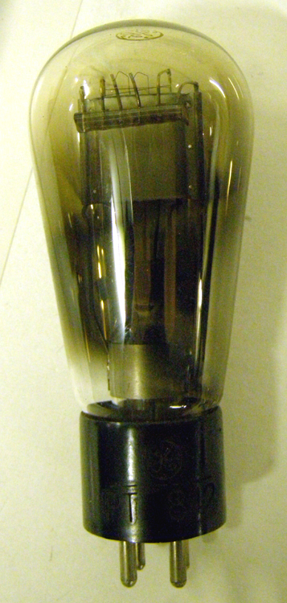
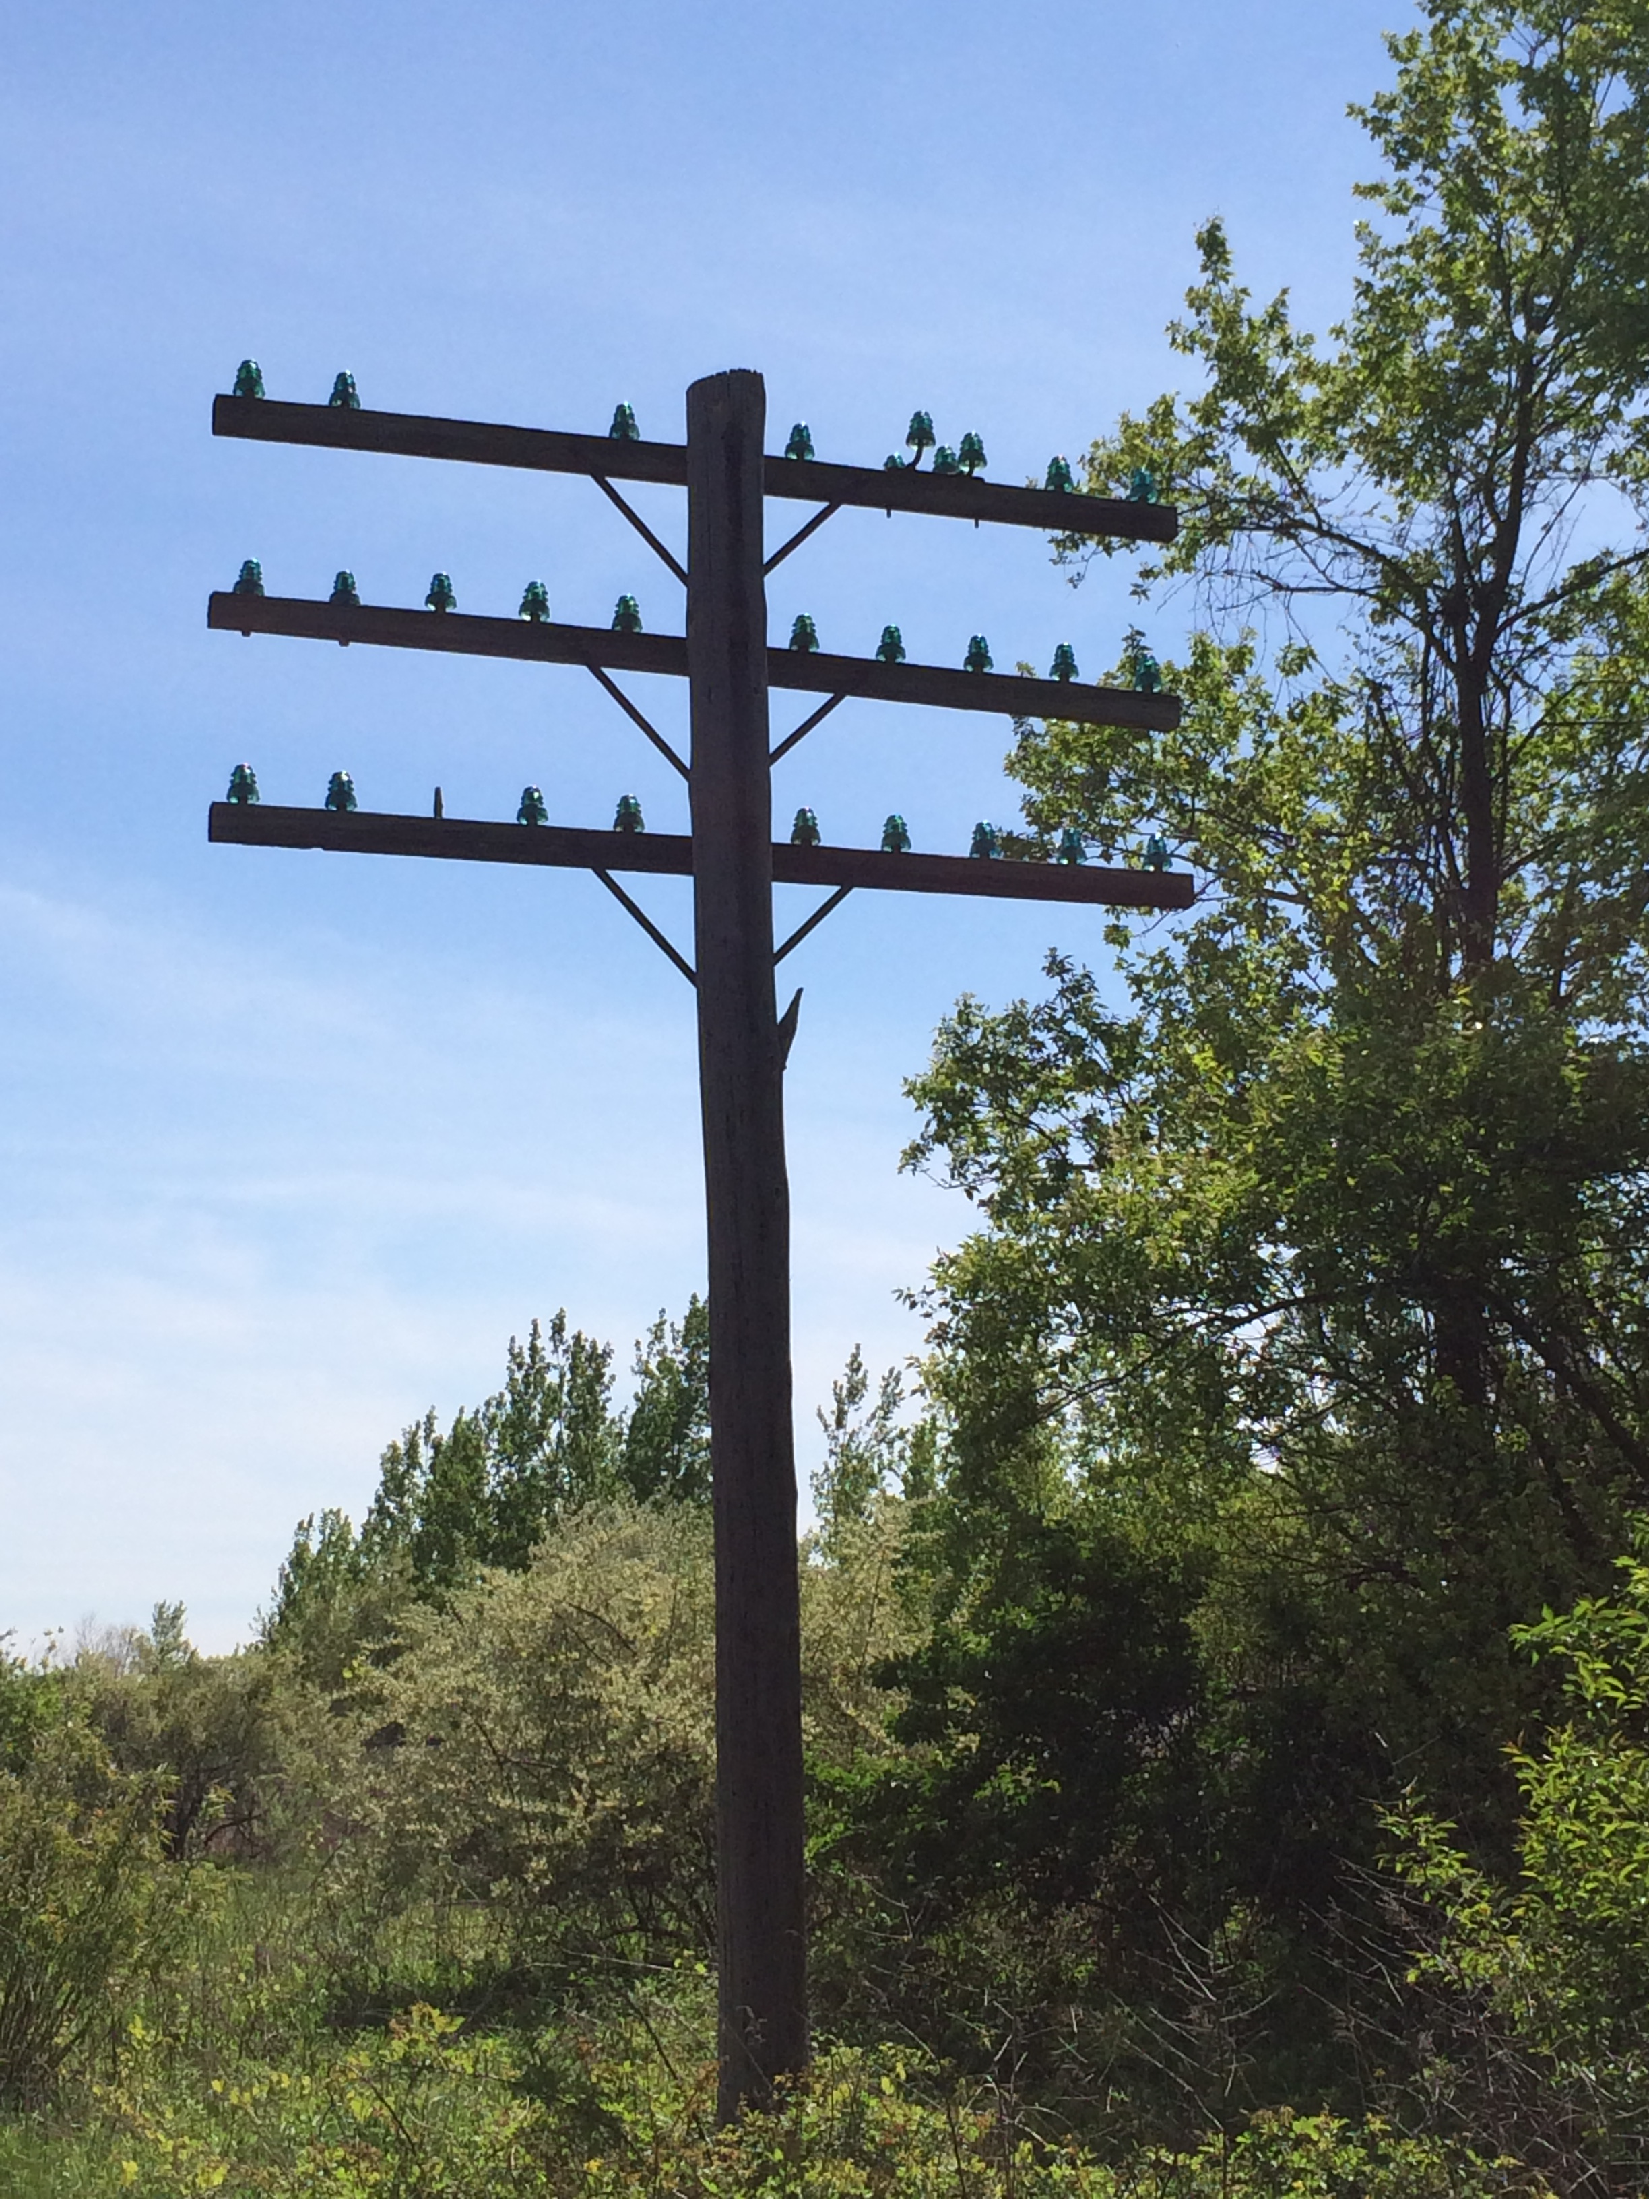
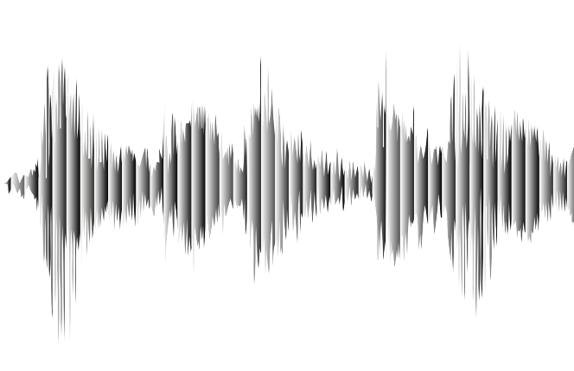
Valves / Tubes / Vacuum Tubes
The first purely electronic devices to store data and do computations were called "Valves" in the UK
About 1000 times faster than physical relays
Designed to amplify analog signals
Early application long distance analog telephone calls – needed an amplifier every 10 miles or so
Tube was invented in 1912 Dr. Lee De Forest
+
Output
Anode
Grid
Input
Cathode
⏚
https://en.wikipedia.org/wiki/Vacuum_tube

Slide 4
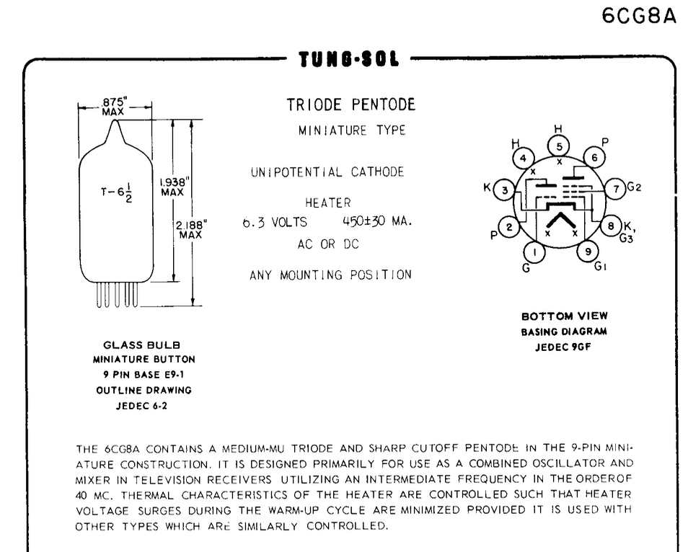
https://frank.pocnet.net/sheets/127/6/6CG8A.pdf

Slide 5
Building "Digital" Valves / Tubes
The design of tubes could be tweaked so to move quickly from low voltage to high voltage as the input voltage increased
Voltage low = off
Voltage high = on
With the correct design, a range of slightly lower input would be lifted on output
Transition
Digital
"Valve"
Audio
Amplifier
Output Voltage
Regenerate
Input Voltage
Notes:
The diagram on this page shows a graph of input voltage and output voltage comparing the response of an amplifier type tube to a tube that is designed more for digital applications (0/1). The amplifier graph starts low and then is a curve going up almost linearly over the range of the input voltage. The digital curve stays low longer and then goes up more vertically before tapering off at the top of the output voltage. The concept is that the transition from low to high if gradual and almost linear for the amplifier and quick and almost vertical for the tube tuned for digital applications. The digital tube goes "vertical" at about the 1/3 point of the input voltage – this means that the tub "pulls up" low non-zero voltages like 0.3 to 1 on output.

Slide 6
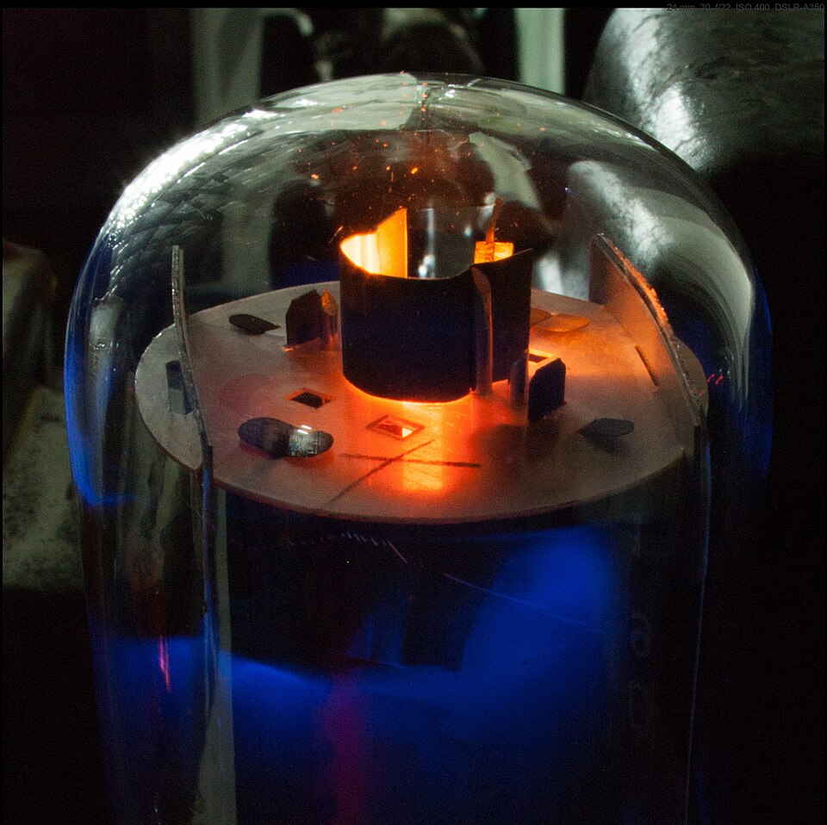
Flaws of Valves
Take lots of power
Lots of heat because tubes had an internal heater that helped release electrons from the cathode.
Physically large
Expensive to manufacture
Soft electronic glow in the dark
https://en.wikipedia.org/wiki/Valve_amplifier

Slide 7
Semi-Conductors

Slide 8
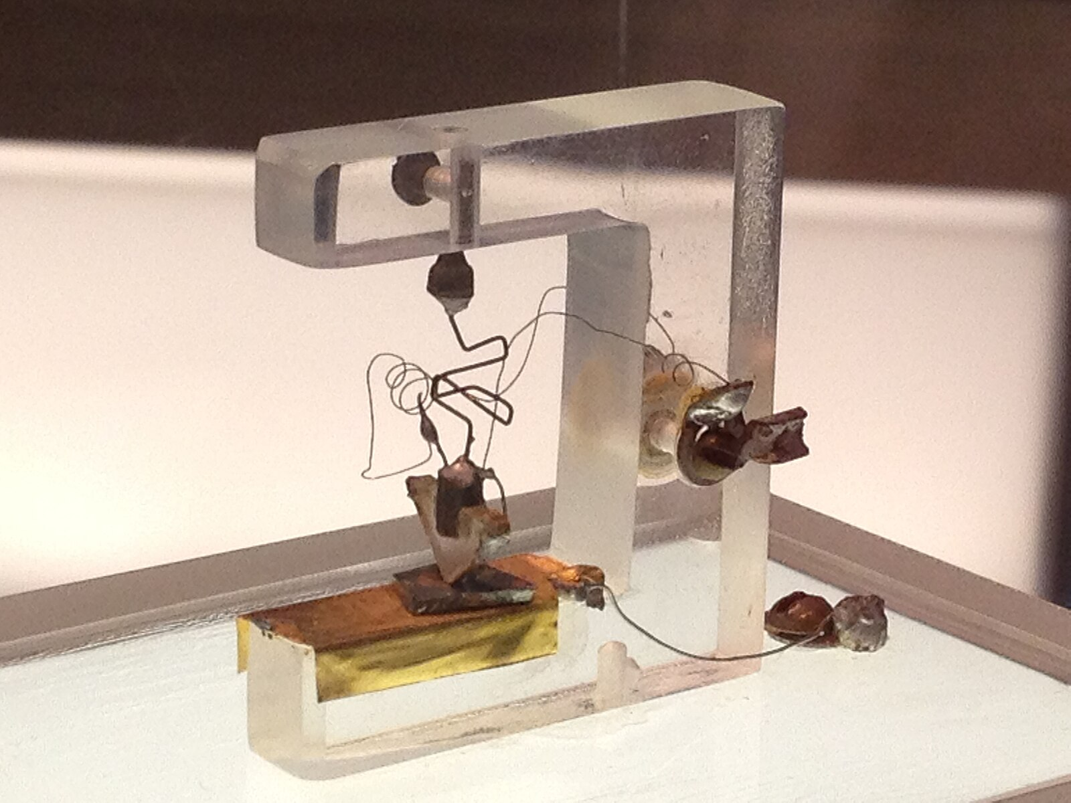
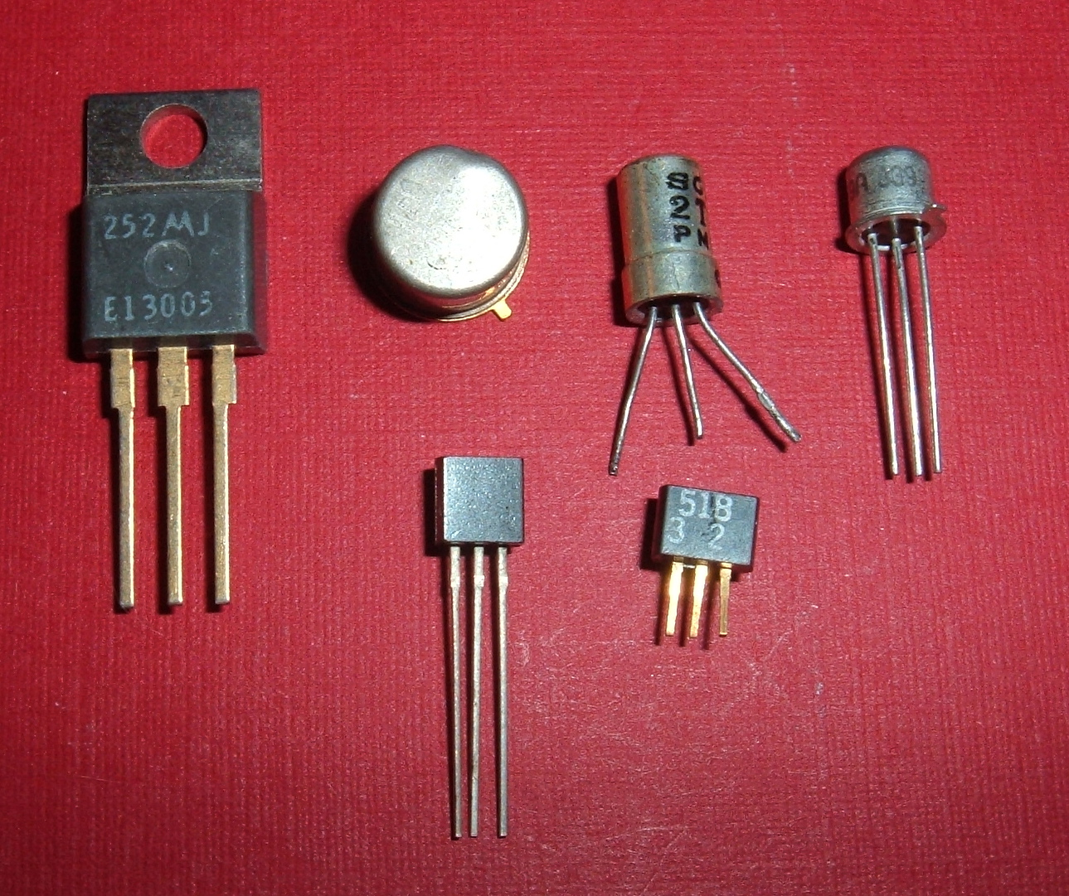
Transistors
Building a better Triode (Tube)
Three kinds of materials w.r.t electricity
Conducting like metal
Insulating like plastic
Semi-conductor
Certain crystalline materials like silicon can be modified by adding impurities (‘doping’) so they conduct electricity under certain conditions — hence, semiconductors.
https://en.wikipedia.org/wiki/Transistor
https://commons.wikimedia.org/wiki/File:1st-Transistor.jpg

Slide 9
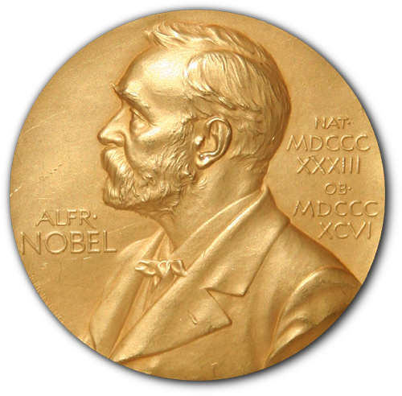

Nobel Prize!
+
Output
Anode
Transistors are constructed by layering crystals with carefully designed impurities
Silicon with N-Doping
Silicon with P-Doping
When voltages are applied to the crystals, sub-atomic stuff happens at the boundaries between the different types of crystals that affect the flow of electrons through the crystals
Grid
Input
Cathode
⏚
+
Output
Emitter
N
P
Base / Gate
Input
N
⏚
Collector
https://en.wikipedia.org/wiki/Nobel_Prize_in_Physics

Slide 10
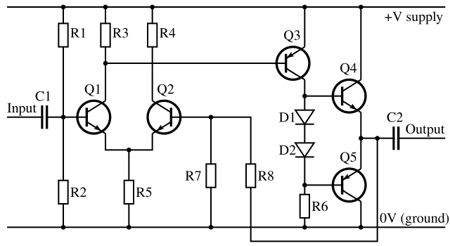
Transistor audio amplifiers – not so simple
A typical transistor amplifier (whether NMOS or BJT) inverts the signal — so an additional stage is used to restore phase.
A few more transistors improve the quality of the amplified signal.
Output
Input
https://en.wikipedia.org/wiki/Amplifier
Notes:
BJT – Bipolar Junction Tranistor

Slide 11
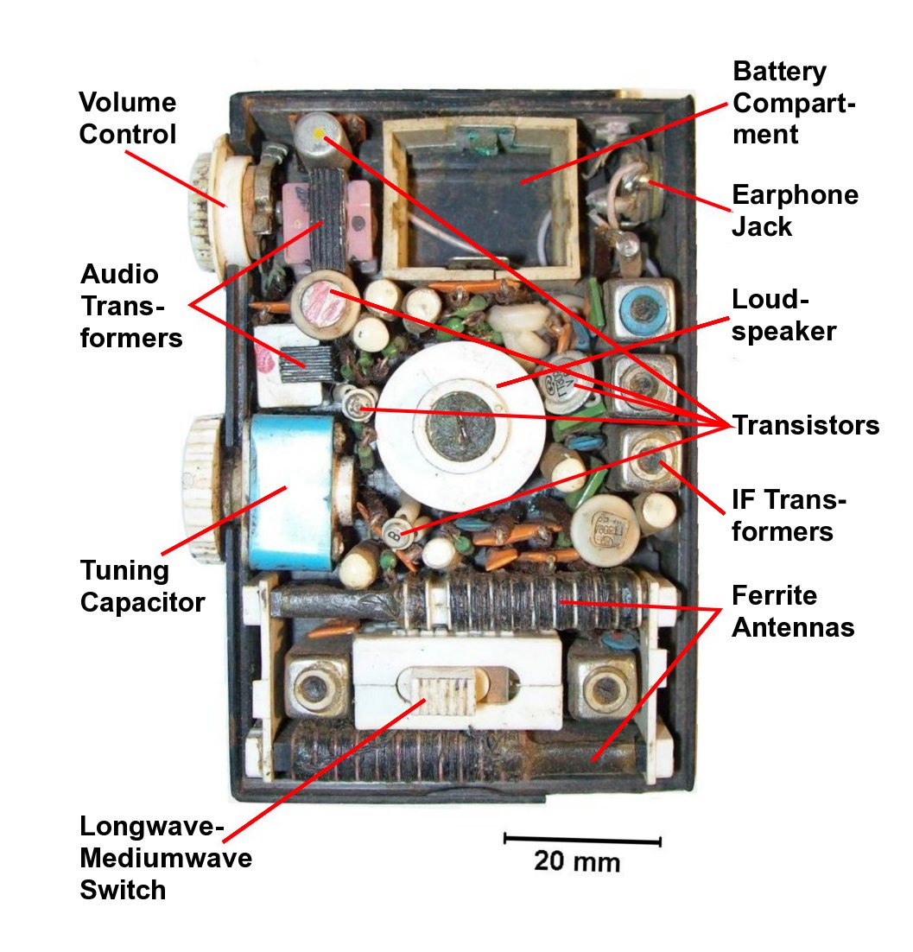
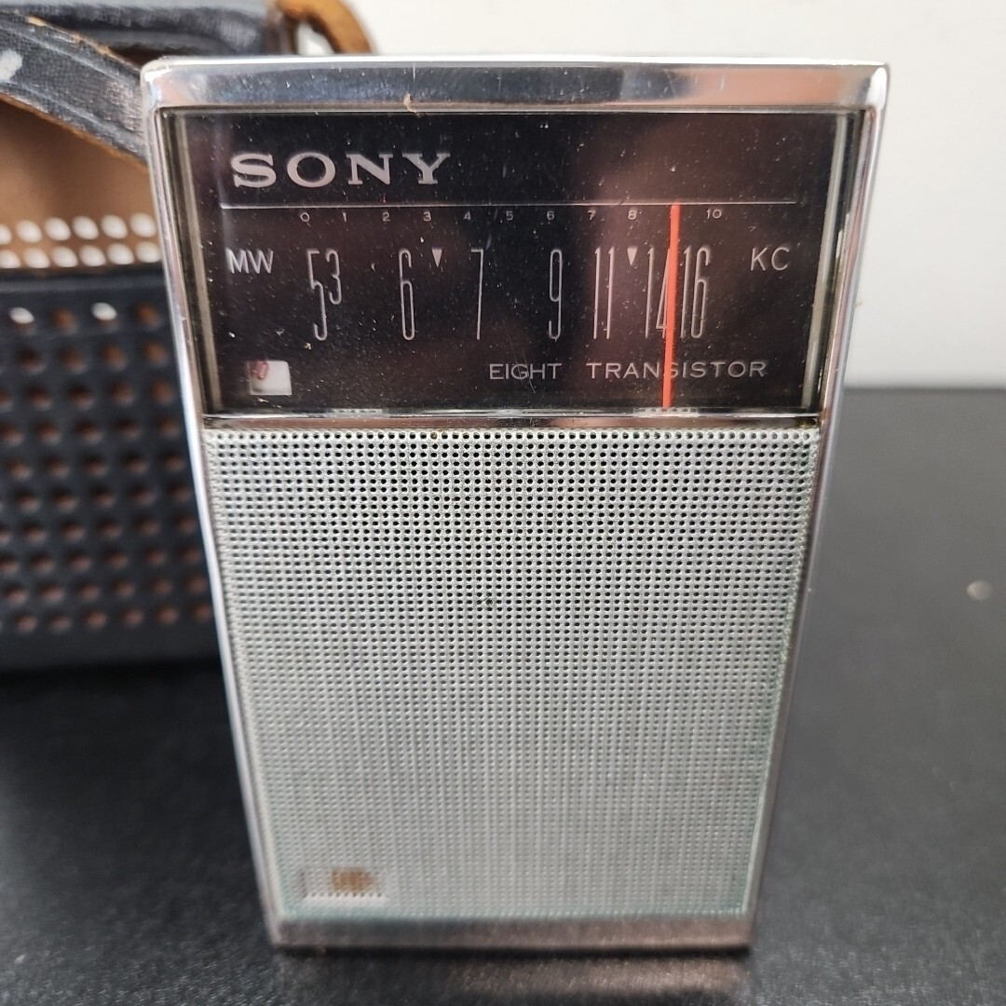
Transistor Radios
Once amplifier style transistors were available, during the 1940's there was an effort to build small, battery-powered "transistor radios"
Often the marketing included the number of transistors – "The Sony TR-826 radio has eight transistors!"
https://en.wikipedia.org/wiki/Transistor_radio

Slide 12
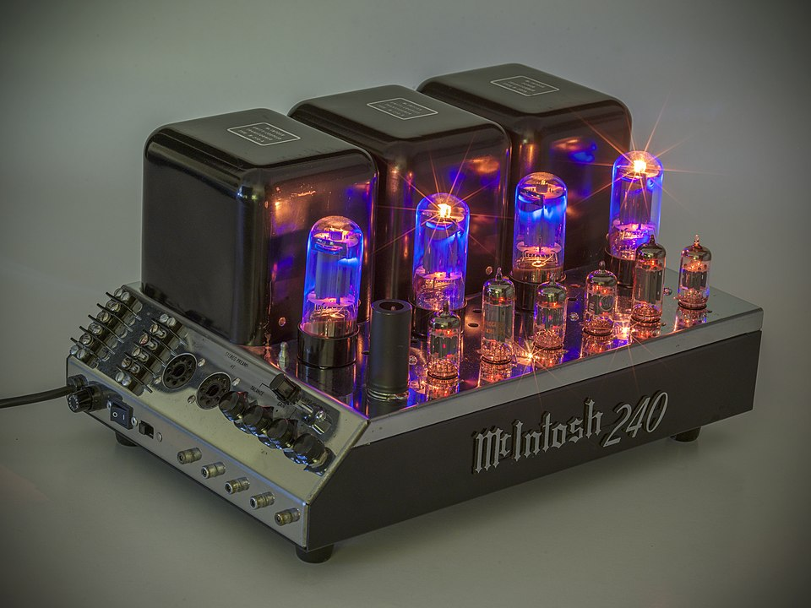
Hi End Tube-Based Audio Amplifiers
Many and professional musical performers feel that that amplifiers that use tubes produce better sound with less distortion
New high-end audio amplifiers can cost upwards of $50,000
This is not an audio class - so back to digital logic ☺
Macintosh MC240 - $3500
https://en.wikipedia.org/wiki/Valve_amplifier

Slide 13
Building "Digital" Transistors
The design of transistors could be tweaked to move quickly from high voltage to low voltage as the input voltage increased
Voltage low = off
Voltage high = on
With the right design, a range of slightly lower input would be corrected on output
AI: Difference between a Bipolar Junction Transistor and NMOS transistor
Transition
Output Voltage
Bipolar
Junction
Transistor
NMOS
Transistor
Input Voltage
Notes:
This is the transistor equivalent of the tube diagram a few slides back. The diagram on this page shows a graph of input voltage and output voltage comparing the response of an amplifier type transistor to a transistor that is designed more for digital applications (0/1). The amplifier graph starts low and then is a curve going up almost linearly over the range of the input voltage. The digital curve stays low longer and then goes up more vertically before tapering off at the top of the output voltage. The concept is that the transition from low to high if gradual and almost linear for the amplifier and quick and almost vertical for the transistor tuned for digital applications. The digital tube goes "vertical" at about the 1/3 point of the input voltage – this means that the transistor "pulls up" low non-zero voltages like 0.3 to 1 on output.

Slide 14
Two Kinds of "Digital" Transistors
Transition
PMOS
NMOS conducts when the input (gate) voltage is high
PMOS conducts when the input is low.
Modern chips use both
CMOS – Complementary Metal-Oxide-Semiconductor
Output Voltage
NMOS
Input Voltage
https://en.wikipedia.org/wiki/MOSFET
Notes:
PMOS (p-channel metal-oxide-semiconductor) refers to a type of field-effect transistor (FET) where the current flow is carried by positively charged "holes"
NMOS (n-type metal–oxide–semiconductor) refers to a type of field-effect transistor (FET) where the channel between the source and drain is made of n-type semiconductor material
The graph on this slide shows an PMOS S-curve going from low to high output voltage with an almost vertical transition at the 2/3 point in the input voltage. The 2/3 point helps pull up voltages that might not quite be 1 on input to 1 on output. The NMOS S-Curve goes from high to low with an almost vertical drop at about the 1/3 point in the input voltage. The 2/3 point helps pull down voltages that might not quite be 1 on input to be 0 on output.
Early logic used PMOS or NMOS depending on what was most effective to manufacture. But the mid 1980s – both NMOS and PMOS could be manufactured in one chip, leading the the use of both on modern chips – we called it CMOS – Complementary Metal-Oxide-Semiconductor. In short NMOS + PMOS = CMOS

Slide 15
The Four Eras of Transistor Manufacturing
Approx. Years | Dominant Technology | Key Feature | Processors | Limitation that Led to Next Step
1950s–1960s | Bipolar Junction Transistor (BJT) | Fast and well-understood |  | Power-hungry, hard to integrate
Late 1960s–early 1970s | PMOS | Easier to fabricate MOS logic | Intel 4004 | Slow, used negative voltages
1973–1983 | NMOS | Faster, simpler power supply | Intel 8080 Zilog Z-80 | Still wasted static power
1983–present | CMOS | Extremely low power, scalable | Intel 486 | Became universal
ChatGPT: Describe the historical timeline for the transition from Bipolar Junction Transistor (BPT) to Complementary Metal-Oxide-Semiconductor (CMOS) transistor technology.

Slide 16
From Transistors to Gates

Slide 17
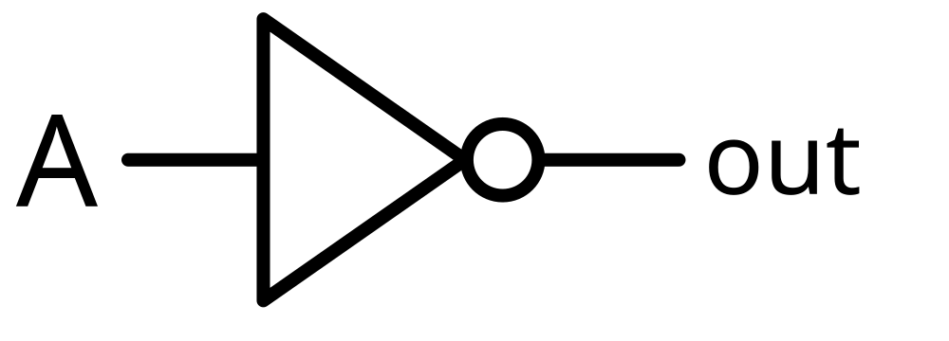
We use transistors to implement "gates"
When we build digital logic we think in terms of abstractions that we call "gates"
Gates let us think about in 1's and 0's instead of voltages
The simplest gate is a "not" gate where the output is the opposite of the input
It demonstrates a circuit that reacts – like a simple "if" statement
We will build more complex logic circuits
Input | Output
0 | 1
1 | 0
https://en.wikipedia.org/wiki/Inverter_(logic_gate)

Slide 18
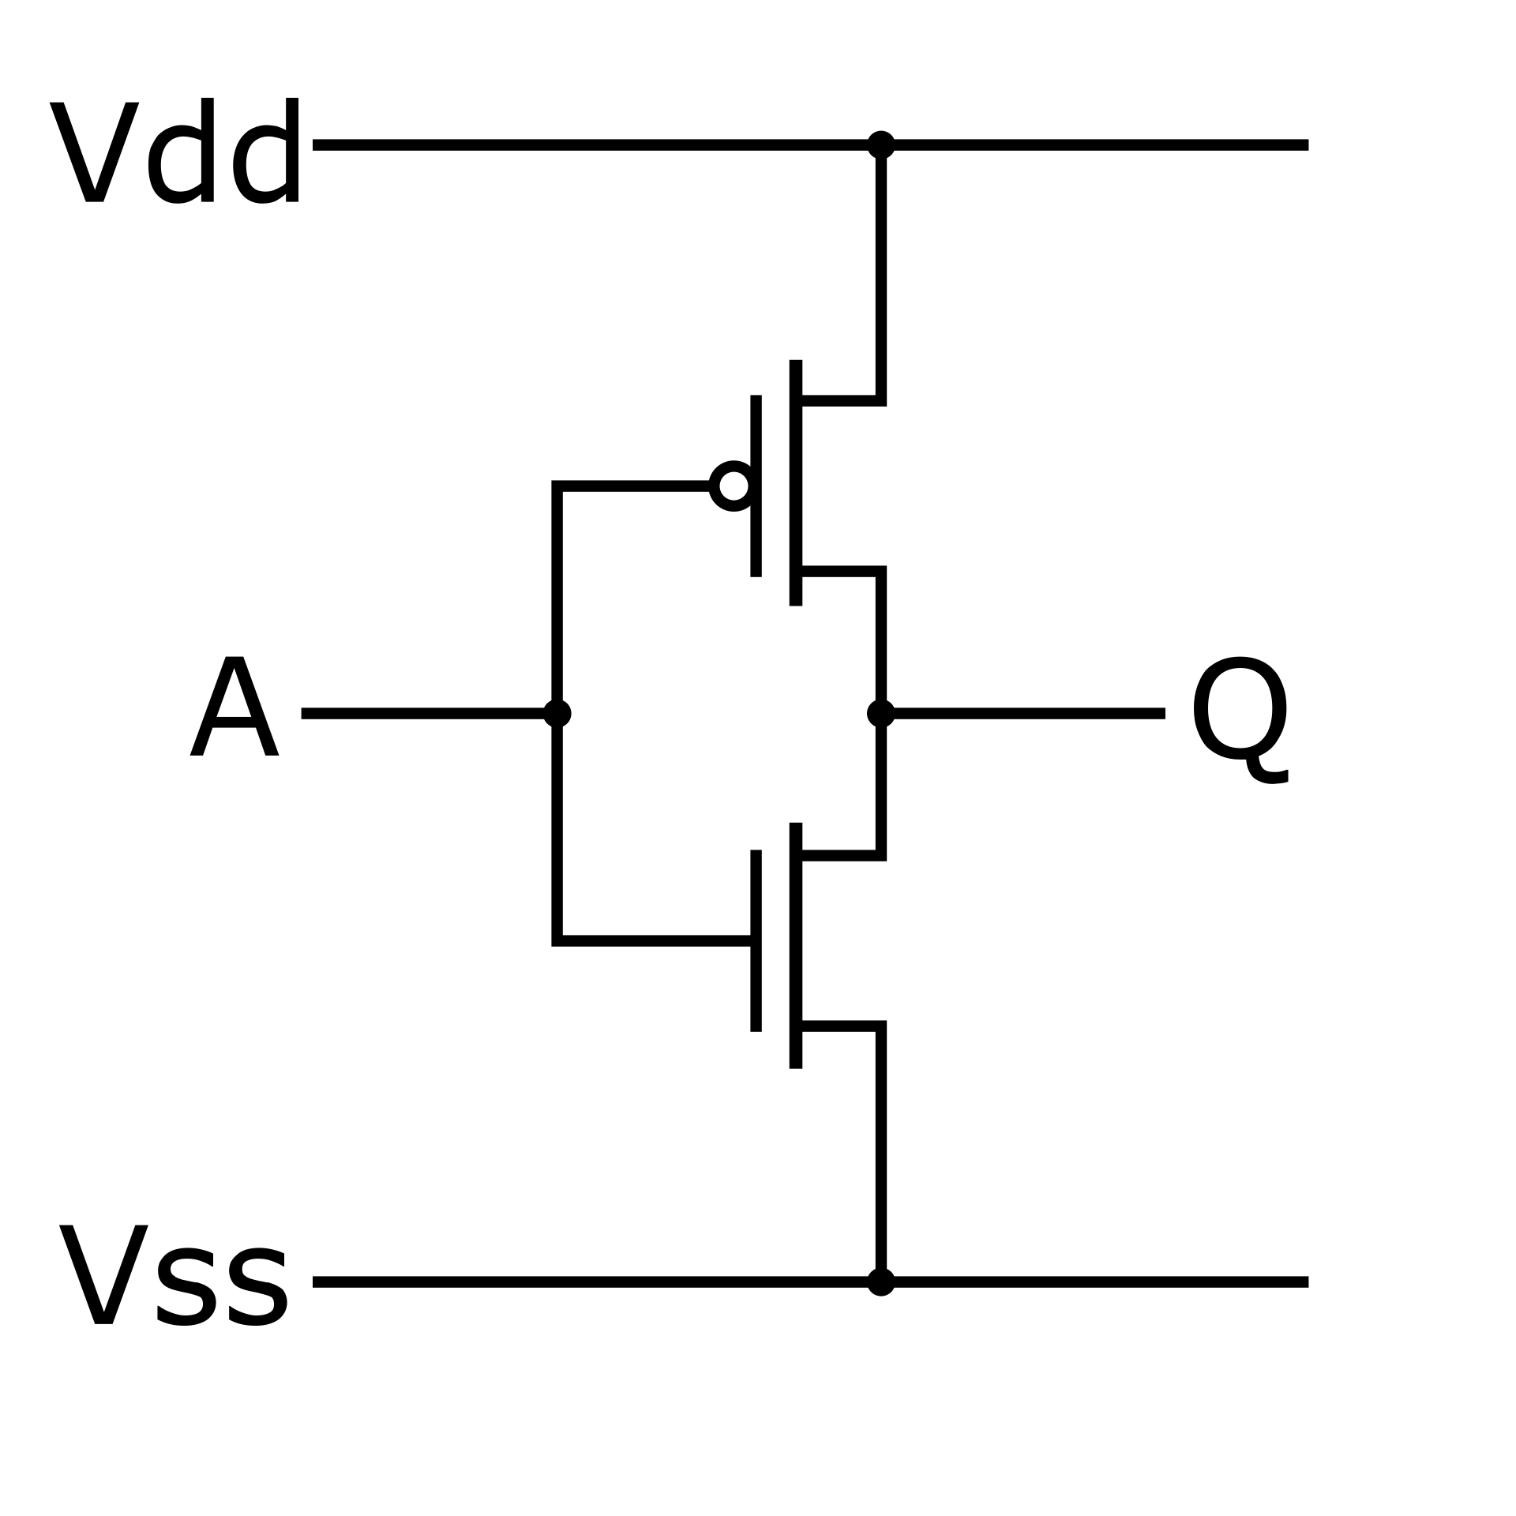
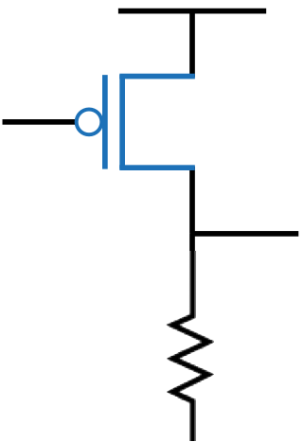
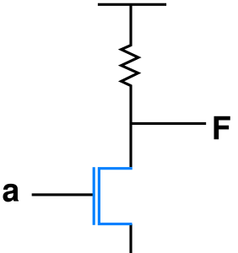
Not gates over time..
Vdd
Vdd
Vdd
A
out
out
A
out
A
⏚
⏚
⏚
PMOS - 1972
NMOS - 1978
CMOS - 1983
Notes:
These not gates show an evolution. In the early 1970s, were easier to manufacture but they were slow and had low density. When the input to a PMOS Not gate is 1 the gate closes, and the output voltage of the transistor is split between the output going to the next gate and the resistor connected to ground. Because of this, the output voltage needs to be "pulled up" by the next gate and the resistor generates heat if the PMOS input is 1. In the late 1970's when manufacturing improved, NMOS transistors could be built with much higher densities. When the input to a NMOS Not gate is 0, the transistor is open (not conducting) and the voltage flows from VCC to the output (1). When the input to the NMOS Not gate is 1, the transistor is closed (conducting) so the output is pulled to ground. Once the transistor is closed current flows directly from VCC to ground and to avoid a short circuit, there is a resistor to limit current from VCC to ground. While the input to the NMOS Not gate is 1, the resistor is using power and generating heat. In Complementary Metal-Oxide-Semiconductor (CMOS) there is both PMOS and NMOS transistors connected to the same input. If the CMOS Not input is zero, the PMOS transistor opens and the NMOS transistor closes and VCC is connected to output with no need for a resistor. When The CMOS Not input is 1, the PMOS transistor closes and the NMOS transistor opens, drawing the output down to (0). CMS Not gates consume very little power and generate very little heat when the input is not changing. There is some heat generated which the input is changing, but overall, the two-transistor CMOS approach uses far less power and generates far less hear than either of the single transistor Not gates. CMOS can handle far greater densities and switching speeds without damage and continues to be the dominate approach in modern chips.

Slide 19
Not gates over time..
Vdd
Vdd
Vdd
A
❄
❄
0
out
out
A
out
1
1
1
0
♨️
A
🚫
🚫
0
⏚
⏚
⏚
PMOS - 1972
NMOS - 1978
CMOS - 1983
Notes:
These not gates show an evolution. In the early 1970s, were easier to manufacture but they were slow and had low density. When the input to a PMOS Not gate is 1 the gate closes, and the output voltage of the transistor is split between the output going to the next gate and the resistor connected to ground. Because of this, the output voltage needs to be "pulled up" by the next gate and the resistor generates heat if the PMOS input is 1. In the late 1970's when manufacturing improved, NMOS transistors could be built with much higher densities. When the input to a NMOS Not gate is 0, the transistor is open (not conducting) and the voltage flows from VCC to the output (1). When the input to the NMOS Not gate is 1, the transistor is closed (conducting) so the output is pulled to ground. Once the transistor is closed current flows directly from VCC to ground and to avoid a short circuit, there is a resistor to limit current from VCC to ground. While the input to the NMOS Not gate is 1, the resistor is using power and generating heat. In Complementary Metal-Oxide-Semiconductor (CMOS) there is both PMOS and NMOS transistors connected to the same input. If the CMOS Not input is zero, the PMOS transistor opens and the NMOS transistor closes and VCC is connected to output with no need for a resistor. When The CMOS Not input is 1, the PMOS transistor closes and the NMOS transistor opens, drawing the output down to (0). CMS Not gates consume very little power and generate very little heat when the input is not changing. There is some heat generated which the input is changing, but overall, the two-transistor CMOS approach uses far less power and generates far less hear than either of the single transistor Not gates. CMOS can handle far greater densities and switching speeds without damage and continues to be the dominate approach in modern chips.

Slide 20
Not gates over time..
Vdd
Vdd
Vdd
♨️
❄
A
🚫
🚫
1
out
out
A
out
0
0
0
1
❄
A
1
⏚
⏚
⏚
PMOS - 1972
NMOS - 1978
CMOS - 1983
Notes:
These not gates show an evolution. In the early 1970s, were easier to manufacture but they were slow and had low density. When the input to a PMOS Not gate is 1 the gate closes, and the output voltage of the transistor is split between the output going to the next gate and the resistor connected to ground. Because of this, the output voltage needs to be "pulled up" by the next gate and the resistor generates heat if the PMOS input is 1. In the late 1970's when manufacturing improved, NMOS transistors could be built with much higher densities. When the input to a NMOS Not gate is 0, the transistor is open (not conducting) and the voltage flows from VCC to the output (1). When the input to the NMOS Not gate is 1, the transistor is closed (conducting) so the output is pulled to ground. Once the transistor is closed current flows directly from VCC to ground and to avoid a short circuit, there is a resistor to limit current from VCC to ground. While the input to the NMOS Not gate is 1, the resistor is using power and generating heat. In Complementary Metal-Oxide-Semiconductor (CMOS) there is both PMOS and NMOS transistors connected to the same input. If the CMOS Not input is zero, the PMOS transistor opens and the NMOS transistor closes and VCC is connected to output with no need for a resistor. When The CMOS Not input is 1, the PMOS transistor closes and the NMOS transistor opens, drawing the output down to (0). CMS Not gates consume very little power and generate very little heat when the input is not changing. There is some heat generated which the input is changing, but overall, the two-transistor CMOS approach uses far less power and generates far less hear than either of the single transistor Not gates. CMOS can handle far greater densities and switching speeds without damage and continues to be the dominate approach in modern chips.

Slide 21
TL;DR – Not Gates Over Time
Before the 1980's, logic gates built from transistors were slow, had low density, took a lot of heat and took a lot of power.
When CMOS was practical in the 1980s, CPUS went from the size of large cabinets to single chips
As size reduced things got much faster
From now on we will only speak of CMOS ☺
Vdd
A
out
⏚

Slide 22
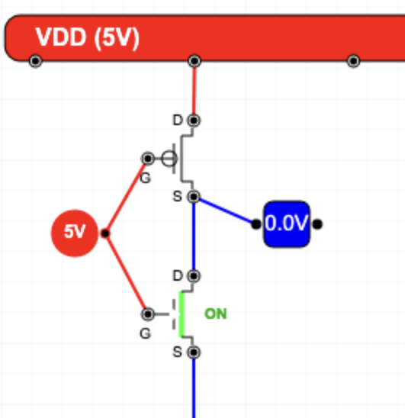
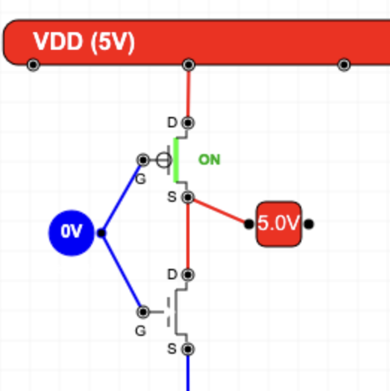
Layout a CMOS NOT Gate (Demo)
https://www.ca4e.com/tools/cmos/

Slide 23
Digital Logic
To design more complex circuits from half-adders to CPUs it is much easier to think in terms of gates than transistors
Gates are an abstraction
On / OFF or 1 / 0
The basic gates come from mathematical logic (and IF statements)
Not / And / Or / Exclusive Or
We also talk about gates that can be built with fewer transistors
NAND / NOR

Slide 24
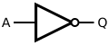
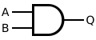
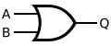
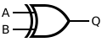
Classic Mathematical Logic Gates
Not
And
Or
Exclusive Or
A | B | Q
0 | 0 | 0
0 | 1 | 0
1 | 0 | 0
1 | 1 | 1
A | B | Q
0 | 0 | 0
0 | 1 | 1
1 | 0 | 1
1 | 1 | 1
A | B | Q
0 | 0 | 0
0 | 1 | 1
1 | 0 | 1
1 | 1 | 0
A | Q
0 | 1
1 | 0
Two transistors
Six transistors
Six transistors
Eight transistors

Slide 25
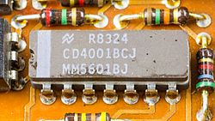
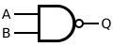
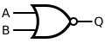
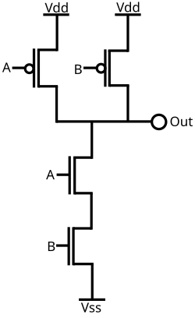
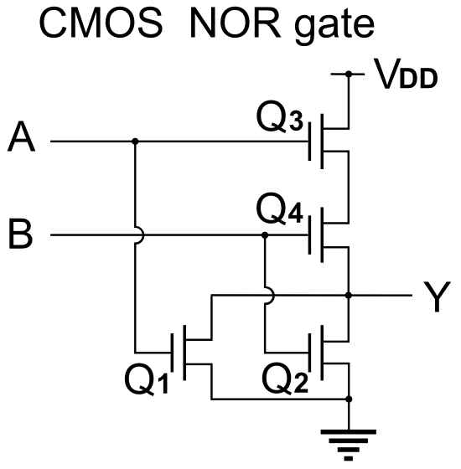
NAND and NOR Fewer transistors
NAND
NOR
A | B | Q
0 | 0 | 1
0 | 1 | 1
1 | 0 | 1
1 | 1 | 0
A | B | Q
0 | 0 | 1
0 | 1 | 0
1 | 0 | 0
1 | 1 | 0
Four transistors
Four transistors
Images: Wikipedia

Slide 26
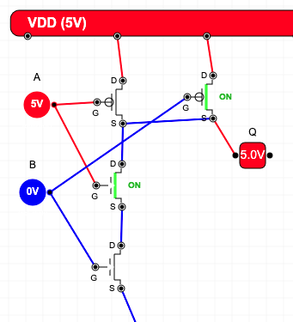
Layout a CMOS NAND Gate
A | B | Q
0 | 0 | 1
0 | 1 | 1
1 | 0 | 1
1 | 1 | 0

Slide 27
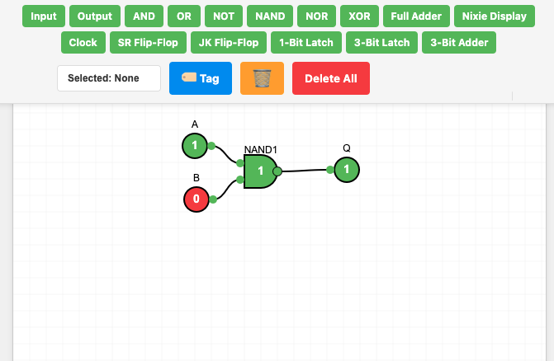
Sneak Peek: Digital Logic Design

Slide 28
Increasing Transistor Count
Improving Manufacturing

Slide 29
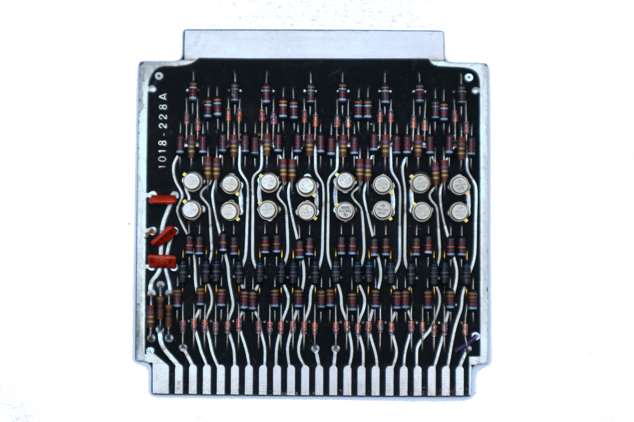
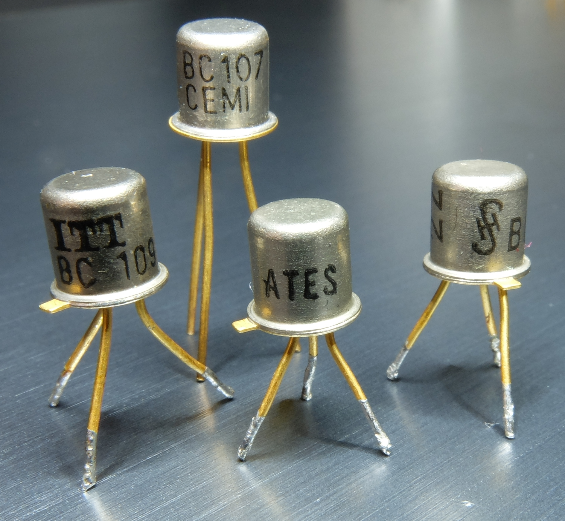
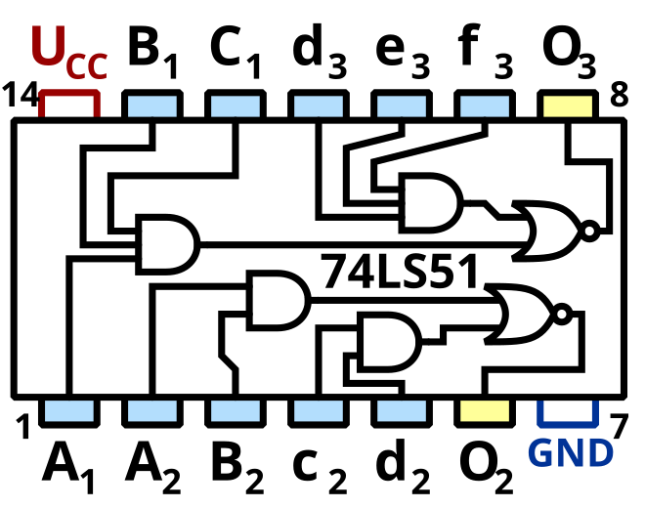
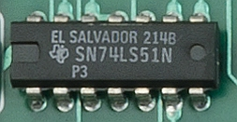
Scale Over Time
Individual transistors connected with other electronics on a "board"
Integrated circuits with a few transistors or gates
https://en.wikipedia.org/wiki/TO-18
https://en.wikipedia.org/wiki/List_of_7400-series_integrated_circuits

Slide 30
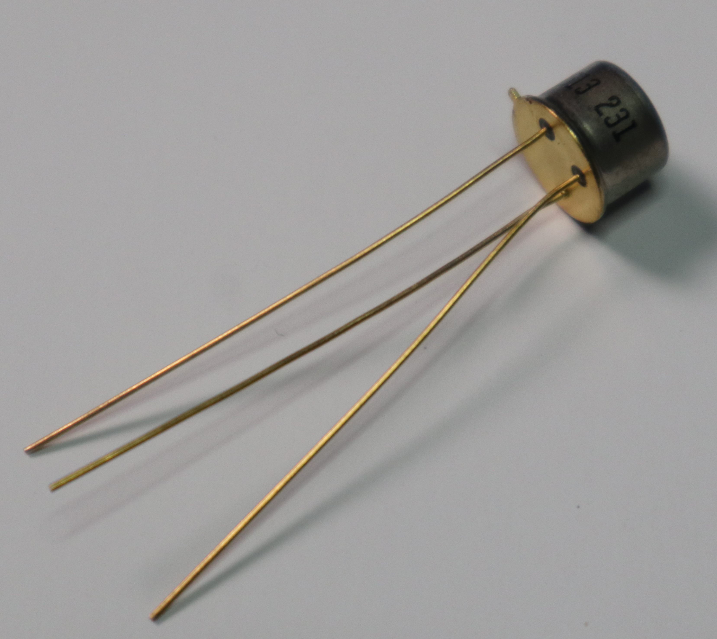
Planar Transistors
Fairchild 2N1613
First planar
transistor
1960
Prior to 1960, transistor assembly required assembling small crystals and connecting wires to them – they were three dimensional "Lego like" constructions
In 1960 Fairchild introduced the 2N1613 transistor – the first that was manufactured by a two-dimensional process.

Slide 31

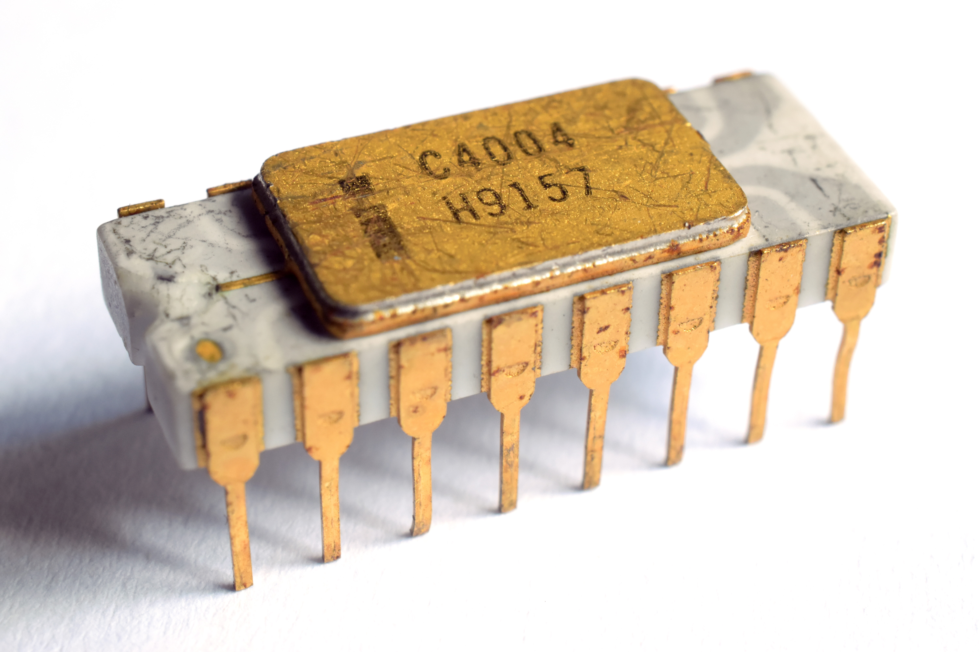
Very Large Scale Integration (VLSI)
2300 PMOS transistors manufactured using photo lithography – 0.01 mm
The Intel 4004(1971), was the first commercially available single-chip, general-purpose microprocessor
3mm
4mm
https://en.wikipedia.org/wiki/Intel_4004
Notes:
An Intel 4004 microprocessors chip - exterior view.
A picture of the internal layout of the Intel 4004 circuitry taken with a microscope showing gates and wires.

Slide 32
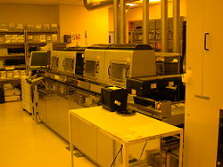
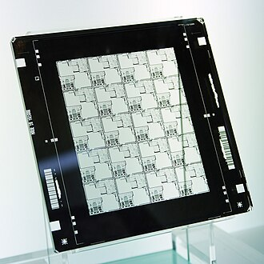
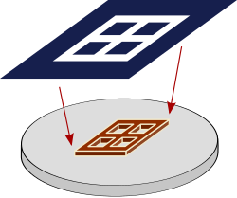
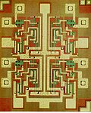
Photo Lithography
Multiple masks with
different chemicals
Four Input NAND
Seven transistors
TI 7420
https://en.wikipedia.org/wiki/Photolithography
https://en.wikipedia.org/wiki/Photomask
https://en.wikipedia.org/wiki/Semiconductor_device_fabrication
Notes:
A photo mask. This photo mask has 20 copies of the same circuit pattern or design. It represents one layer in a chip manufacturing process.
A schematic illustration of a photomask (top) being reduced and projected onto an Integrated Circuit layer (bottom) for printing
NAND gate with 4 inputs in transistor-transistor logic; 7 transistors on the chip as viewed on a microscope.
A close-up of a TI 74LS51 chip installed in a circuit board
A semiconductor device manufacturing facility at HP Labs

Slide 33
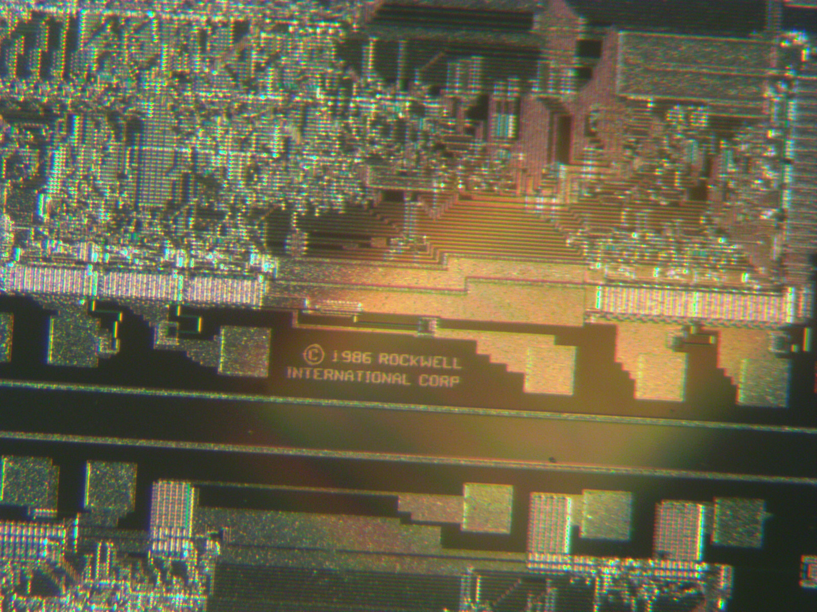
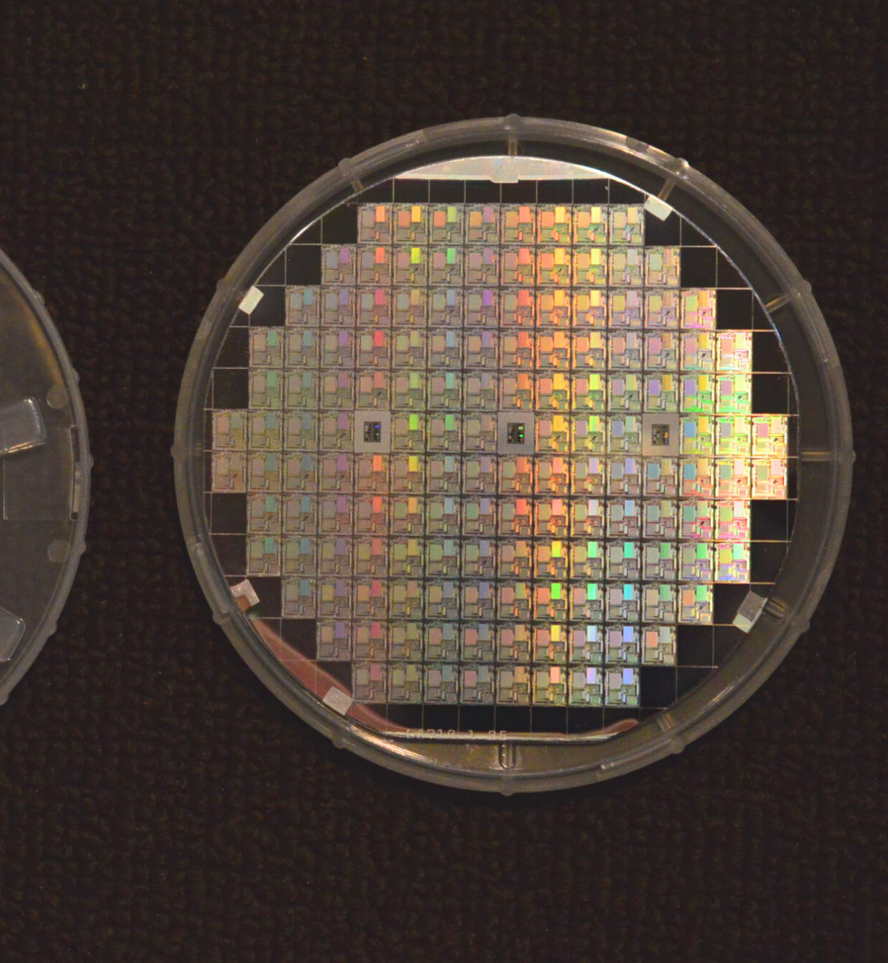
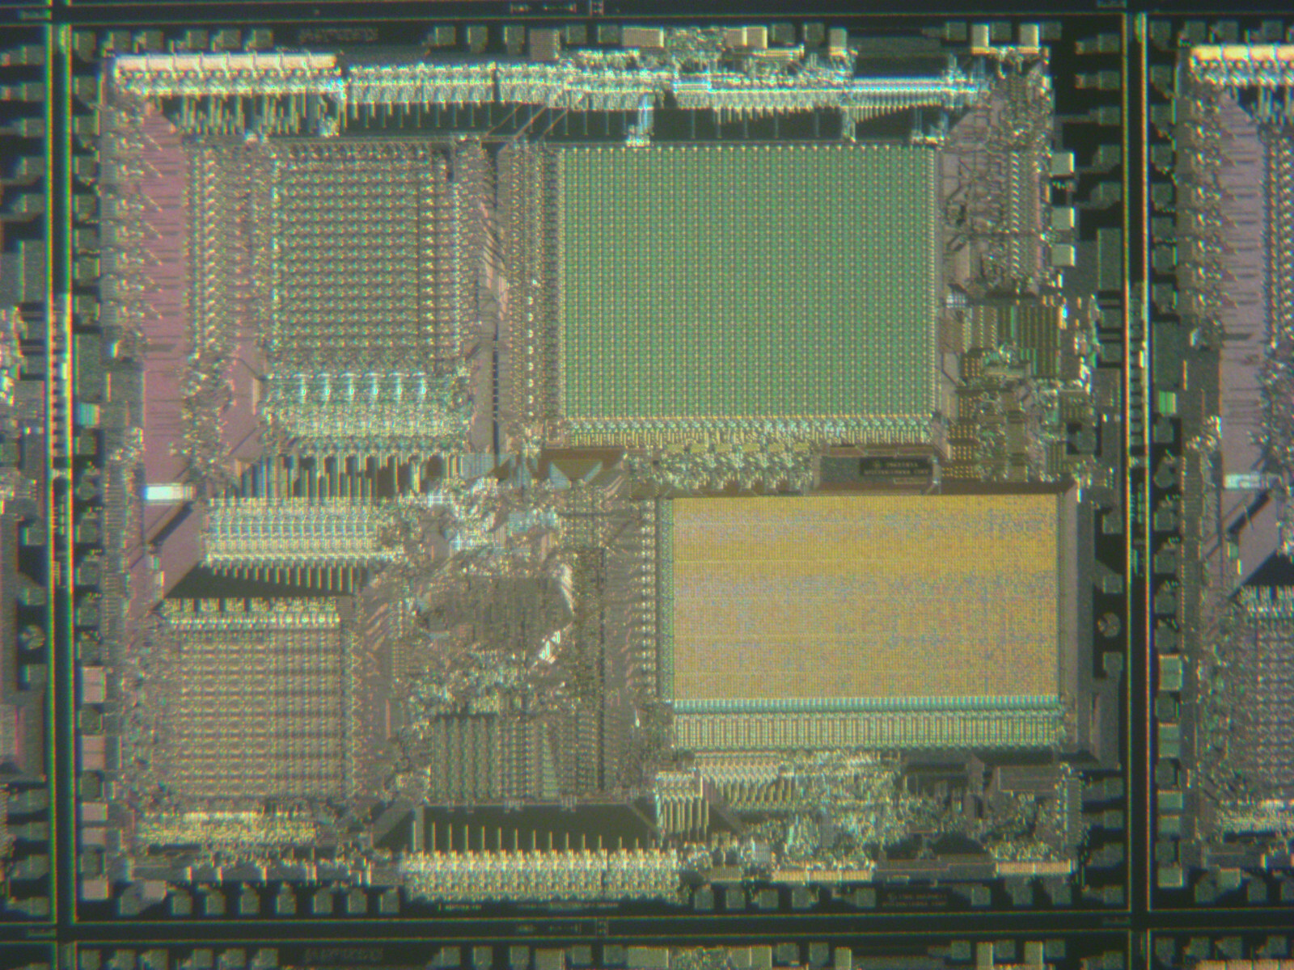
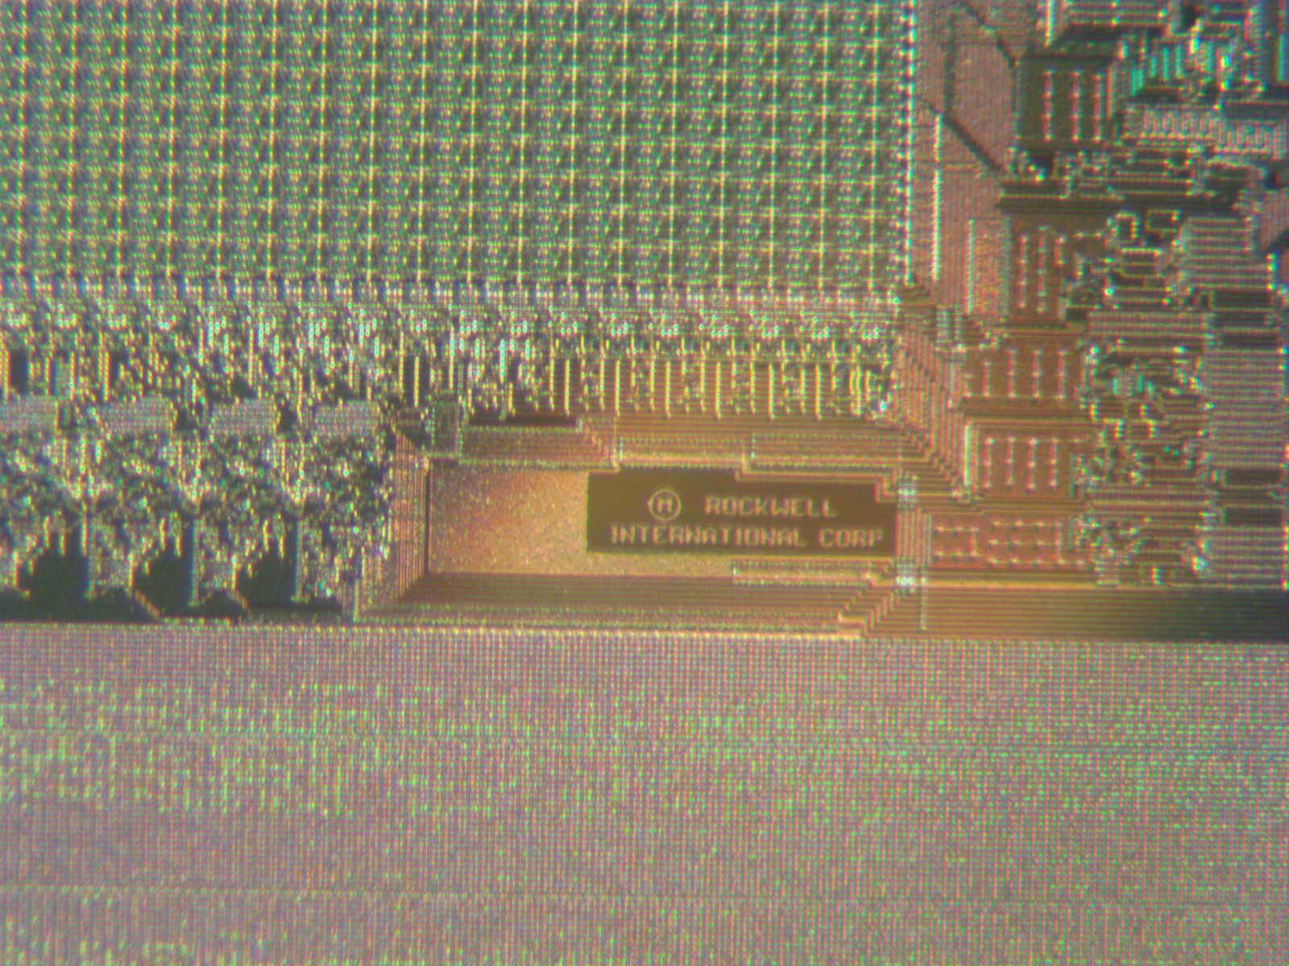
Rockwell silicon wafer (1986)
Fairchild 2N1613
First planar
transistor
1960
Photos courtesy of ebay user kaijusears
Notes:
A Fairchild 2N161e transistor. It is a metal cylinder about 1/4 inch in diameter and 1/4 inch tall. It has three wires coming out of the base. The Fairchild 2N1613 Transistor was produced and commercially available in 1962. It was the first planar transistor ever produced and was a great step forward in mass-producing individual transistors.
Complete Rockwell silicon wafer (1986) it is round and about 4 inches in diameter with very intricate almost microscopic electrical traces and transistors. It has about 120 chips and each chip is about 1/4 inch on a side.
Close up of a single 1/4 inch processor from the Rockwell silicon wafer (1986). It was taken with a microscope at about a 10X magnification and you still cannot see any individual wires because they are so small.
Close up of the edge of s single 1/4 inch processor from the Rockwell silicon wafer (1986). It was taken with a microscope at about a 30X magnification, and you scan finally see contacts and a few wires. It also has a “Copyright 1986 Rockwell International Corp” marking printed on the chip.
Photos courtesy of ebay user kaijusears

Slide 34
Growth of transistor count
The Intel 4004 had 2300 transistors in 1971
The Intel Itanium was the first billion-transistor chip in 2001
Deep learning wafer scale engine by Cerebras has 2.6 trillion MOSFETs 2020
2 Terabyte flash memory with 5.3 trillion floating-gate MOSFETs
Nvidia's Blackwell-based B100 GPU with 208 billion MOSFETs in 2024
https://en.wikipedia.org/wiki/Transistor_count

Slide 35
Very Large Scale Integration (VLSI) Layout
Building circuits with millions of transistors through photo lithography

Slide 36
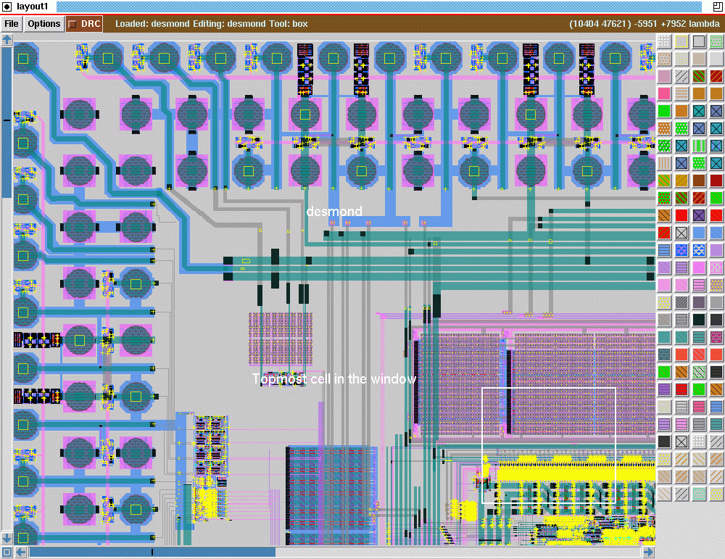
Magic Open Source VLSI Design Tool
Created at Berkeley in 1983
Open source
Popular in academia
Many tutorials
http://opencircuitdesign.com/magic/

Slide 37
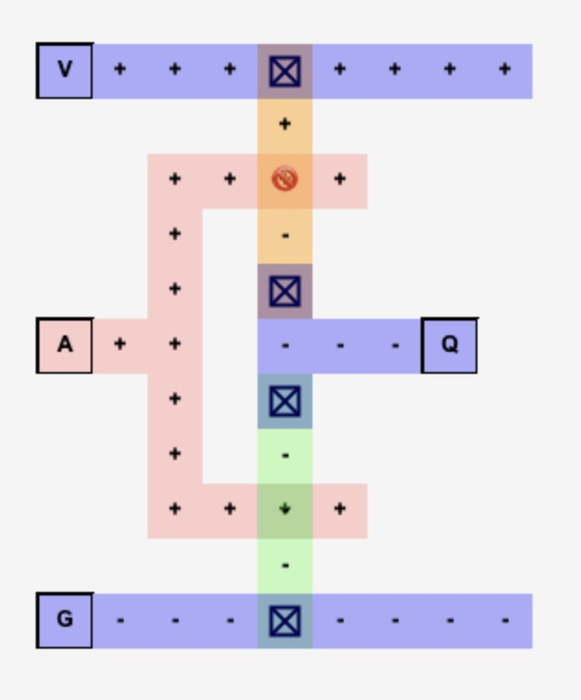
About My Emulators
My circuit layout and emulation tools are limited
Focused on learning objectives of the course
Run in the browser
They fail if circuits get too complex
There are many emulators that are more serious and more accurate – just search

Slide 38
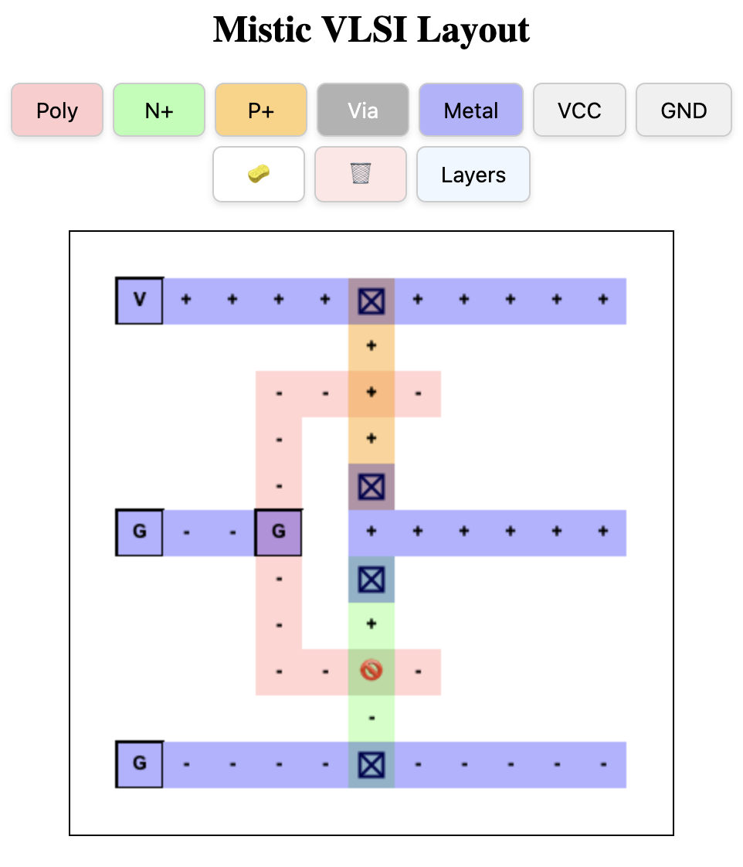
VLSI CMOS Not
Vdd
Not
A
out
A | Q
0 | 1
1 | 0
⏚

Slide 39
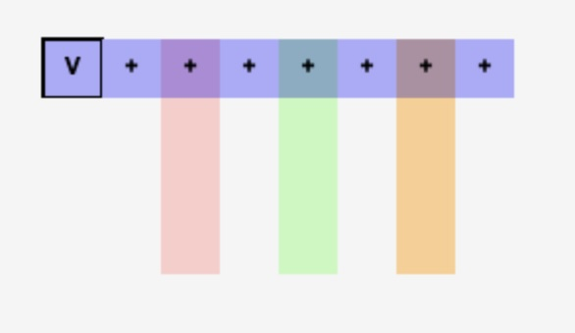
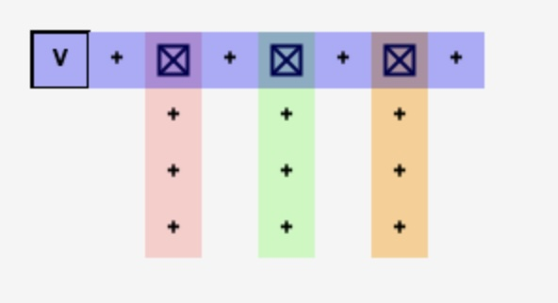
Drawing Layers
Metal – Conductor
N-Doped Silicon
P-Doped Silicon
Polysilicon
These are not connected unless you place a "Via" at a connection point
The Via is a vertical connector between layers

Slide 40
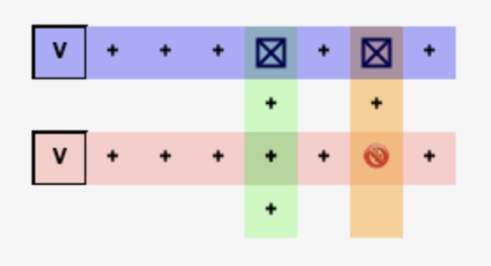
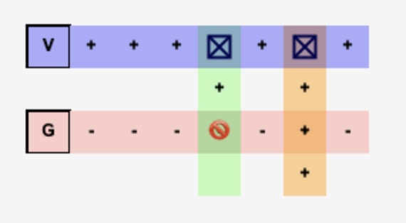
Transistors
When N-Doped Silicon crosses Polysilicon an NMOS Transistor is created
When P-Doped Silicon crosses Polysilicon an NMOS Transistor is created
The voltage on the Polysilicon controls the conductivity of the transistors

Slide 41

About Layout
Mistic is greatly simplified
Mistic circuit emulation is very simple
AI: Explain the differences between VLSI layout as might be used in the Magic circuit design tool and the actual construction of chips on silicon wafers
For example – You can't overlap N+ and P+ due to manufacturing limitations
Cannot be manufactured
Notes:
A picture with the left diagram showing P+ Silicon connecting directly to N+ Silicon with a Via which is not allowed. One the right the N+ and P+ are not touching be a short metal segment and two Vias are used to move current from the P+ to the N+.

Slide 42


Looking at the Layers

Slide 43


VLSI CMOS Not
Vdd
A
out
Input 0
Input 1
⏚

Slide 44

VLSI CMOS NAND
A | B | Q
0 | 0 | 1
0 | 1 | 1
1 | 0 | 1
1 | 1 | 0

Slide 45

VLSI CMOS NAND
A | B | Q
0 | 0 | 1
0 | 1 | 1
1 | 0 | 1
1 | 1 | 0

Slide 46
Summary
Semiconductors
Tuning tubes and transistor for digital applications (as compared to amplifier applications)
Building gates from transistors
Transistor technology evolution PMOS, NMOS and CMOS logic
Number of transistors on a chip over time
Photo lithography
Designing VLSI chips

Slide 47
Acknowledgements / Contributions
These slides are Copyright 2025- Charles R. Severance (online.dr-chuck.com) as part of www.ca4e.com and made available under a Creative Commons Attribution 4.0 License. Please maintain this last slide in all copies of the document to comply with the attribution requirements of the license. If you make a change, feel free to add your name and organization to the list of contributors on this page as you republish the materials.
Initial Development: Charles Severance, University of Michigan School of Information
Insert new Contributors and Translators here including names and dates
Continue new Contributors and Translators here

